Slide 1
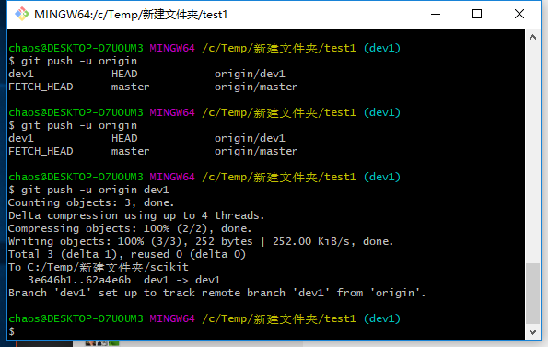
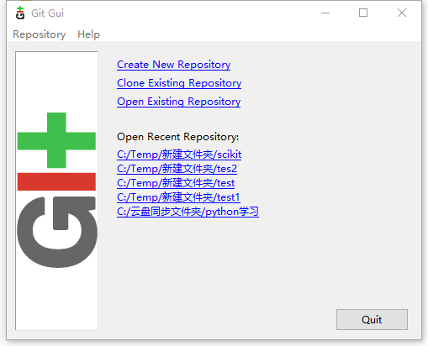
Download Git：https://git-scm.com/download/win
BASH
GUI

Slide 2
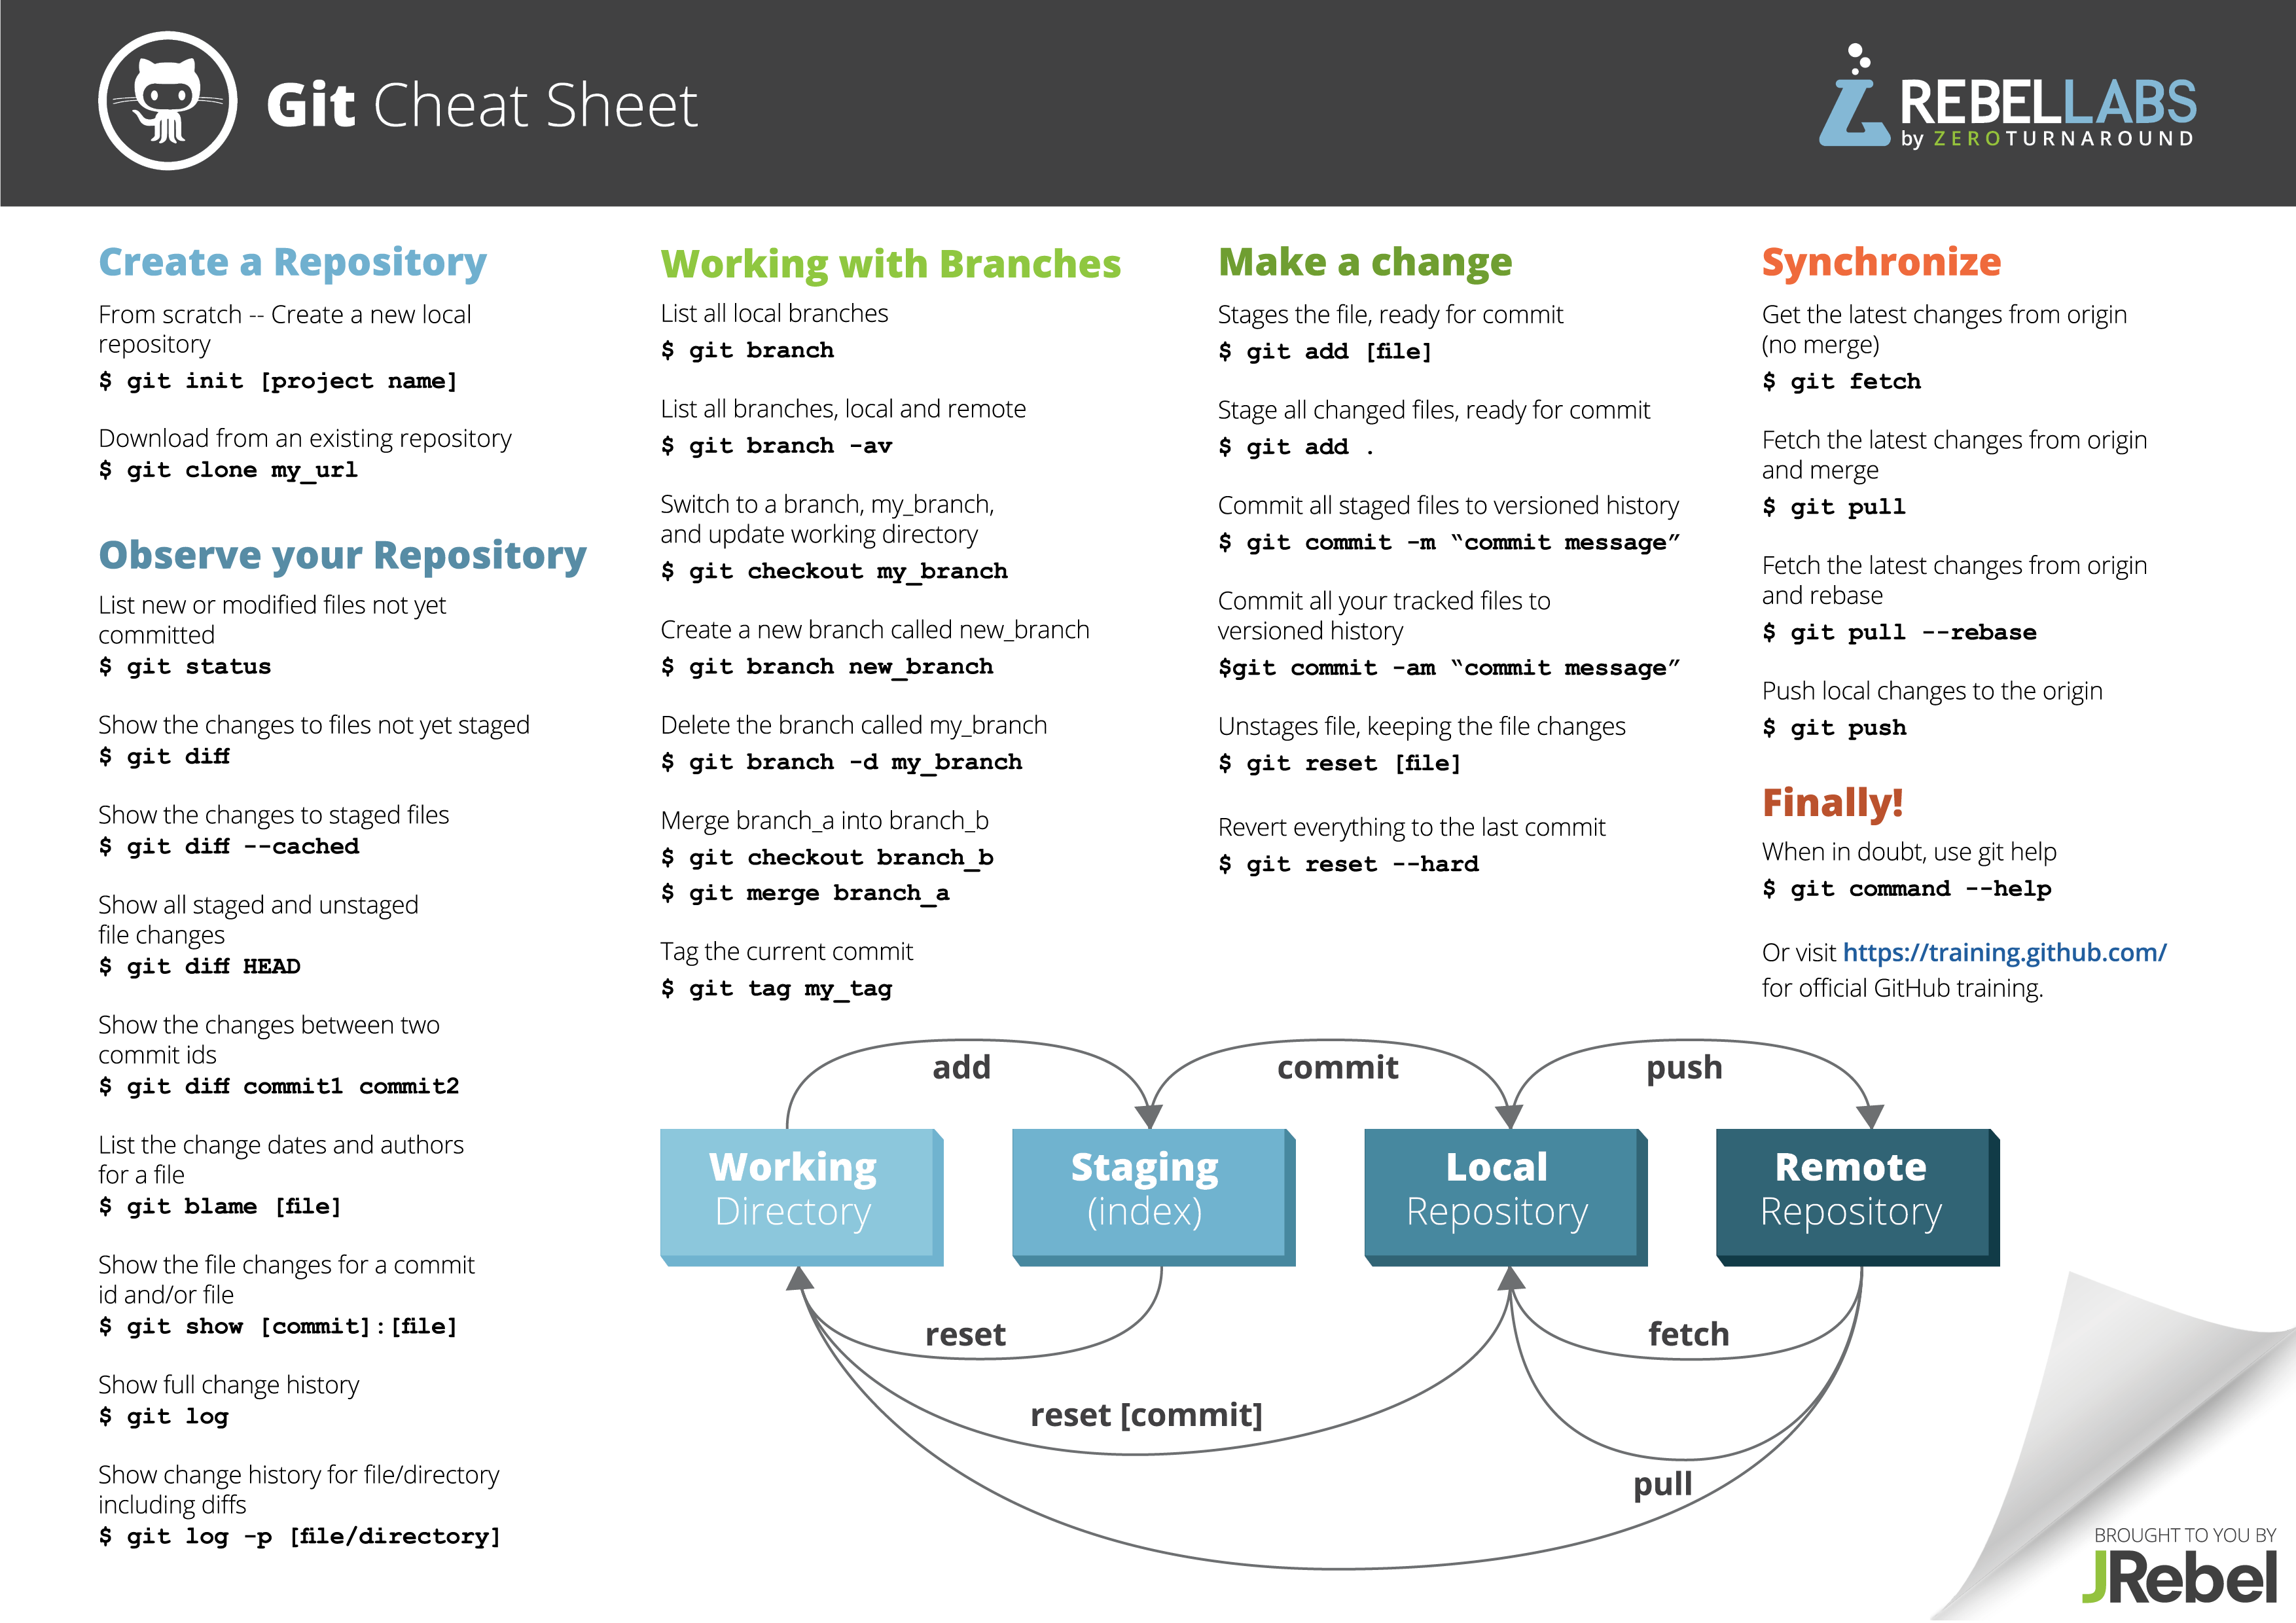

Slide 3

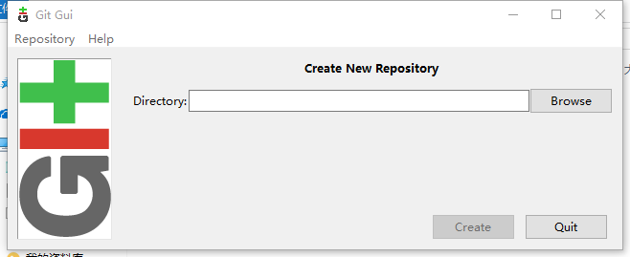
$ git config --global user.name "superGG1990"
$ git config --global user.email "superGG1990@163.com"
Creat Repository
selecting dir. to create repository
Bash: git init dir

Slide 4
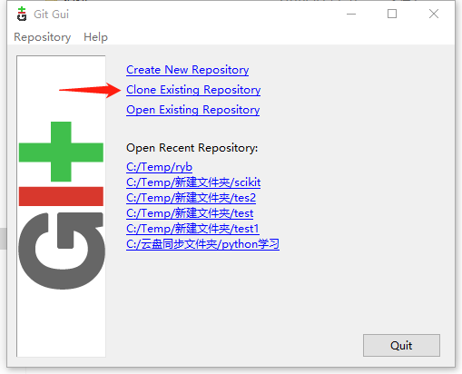
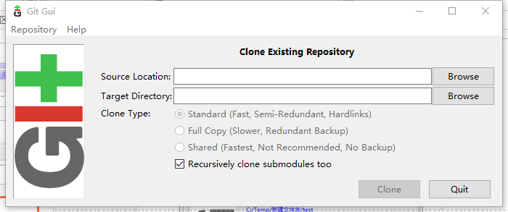
Clone Repository
Bash: git clone source_location target_location

Slide 5
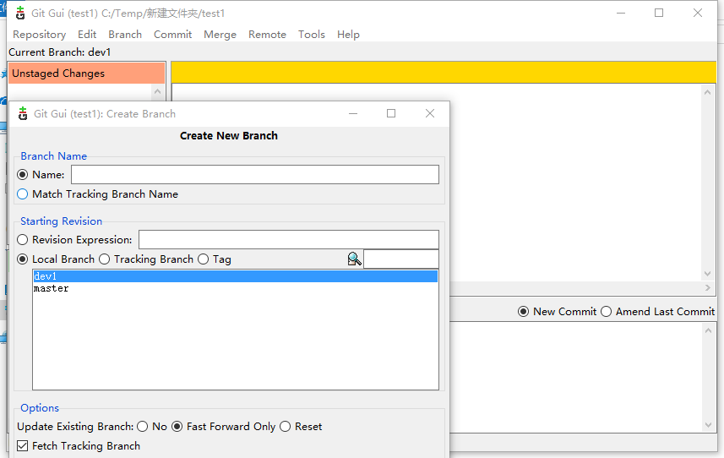
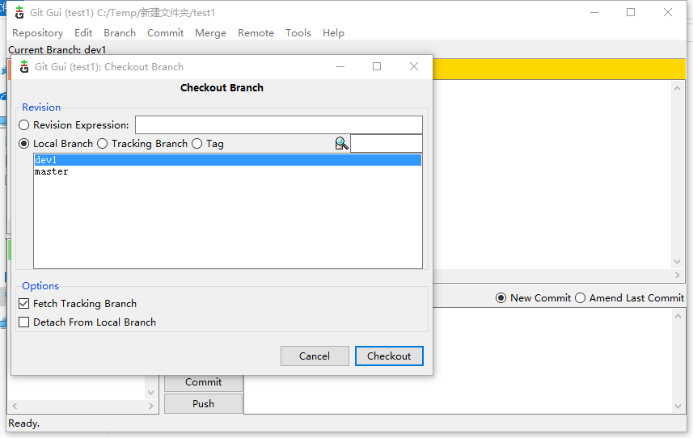
Create Branch
Caution: Master branch should be always protected to avoid being modified by user.
User can create a personal branch or checkout other user’s branch to modify program.
Creat branch
Checkout local branch or tracking branch(source repository)
Bash: git branch branch_name
Bash: git checkout branch_name

Slide 6
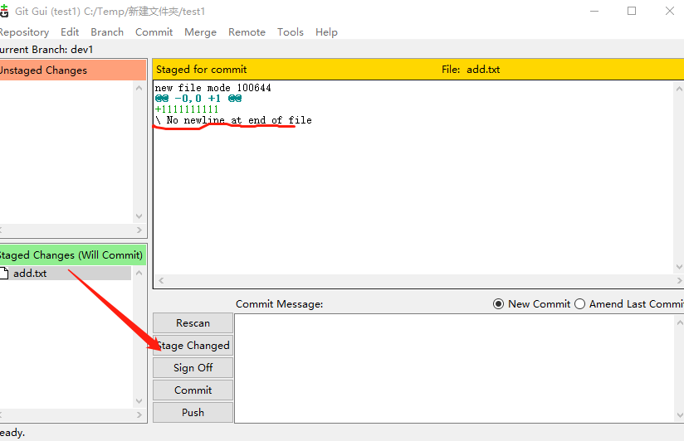
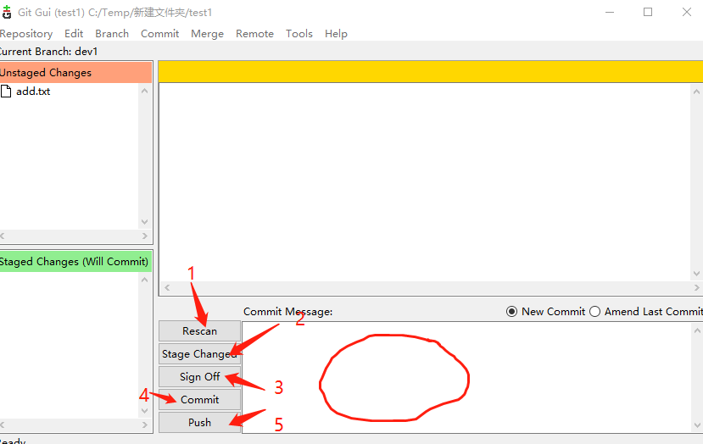
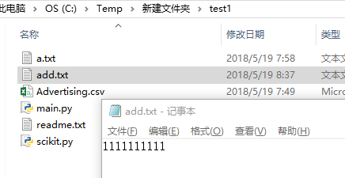
Add a file in repository
1. Add “add.file” to repository
Commit message must be filled，
And “Sign off” can be ignored!
File modify log
Bash: git add file_name(or –A ) –A all modified files
git commit –m ‘message’
git push (first time append “-u repo_name branch_name”)

Slide 7
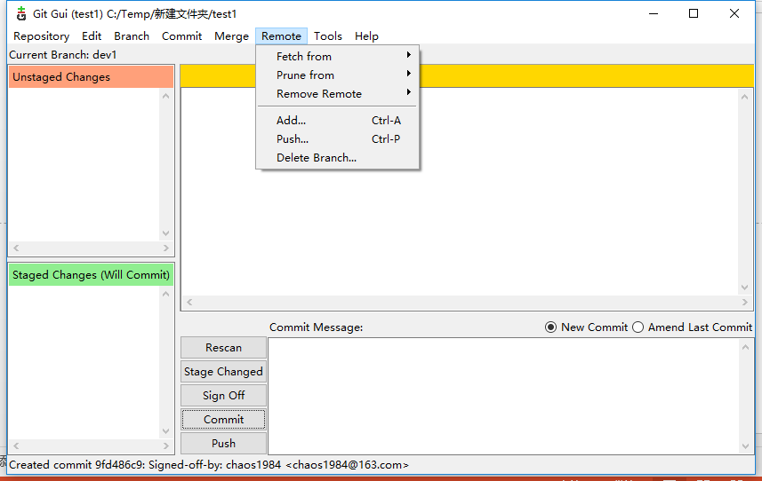
Update local repo. from source repo
If source repo is update, user also update local repo.
Bash: git fetch repo_name brach_name(recommend)
git pull repo_name brach_name

Slide 8
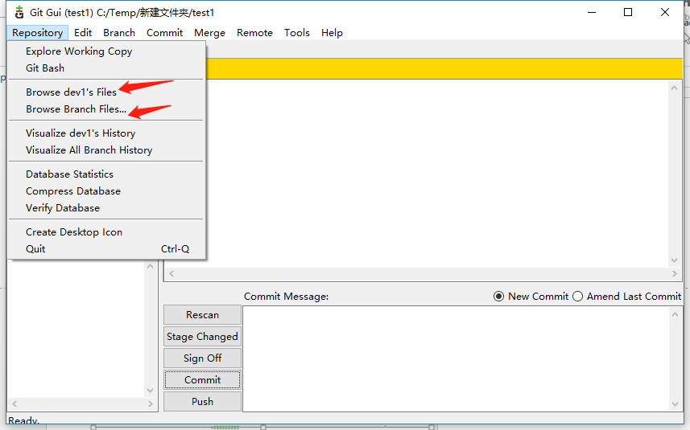
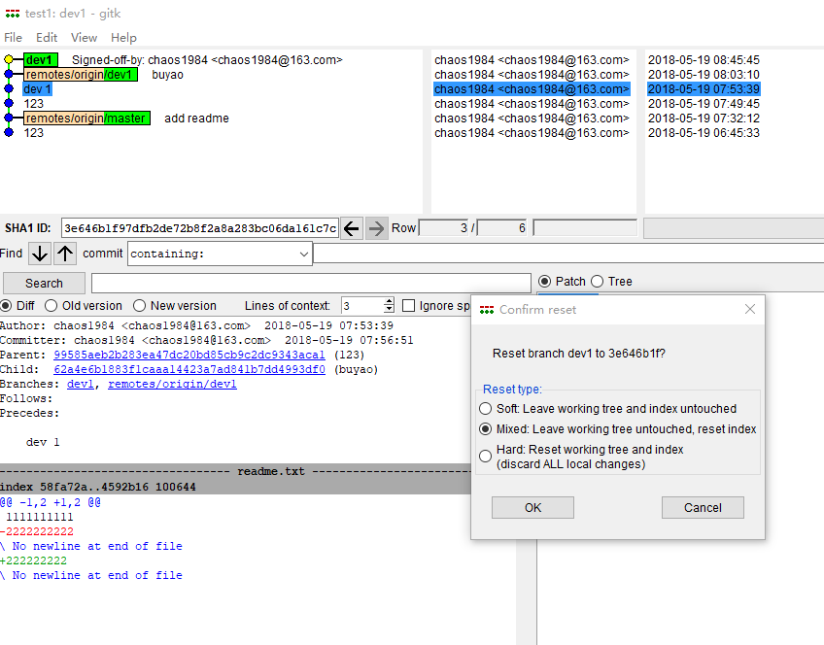
Reset current HEAD to the specified state
Previous version: git reset --hard HEAD^
Specify version: git reset --hard HEAD~version_num
Caution: HARD is dangerous!

Slide 9
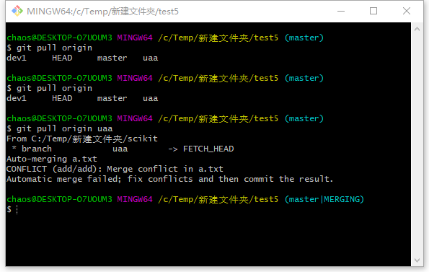
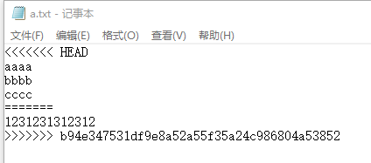
CAUTION :Files conflicts

Slide 10
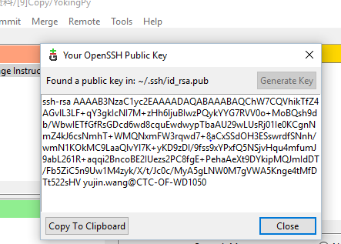
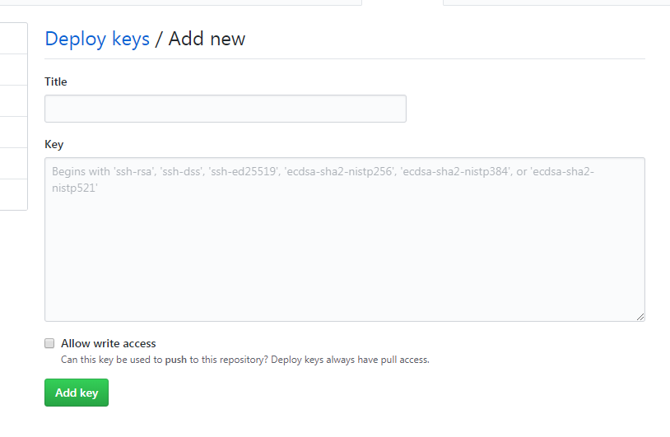

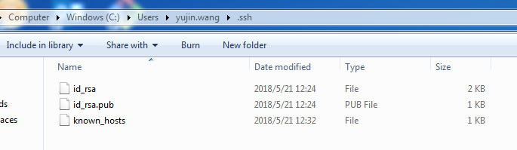
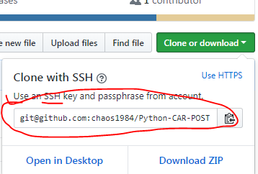
Github Configure
1.ssh-keygen
Run git
ssh-keygen -t rsa “user@mail” (reference :p1 )
4.Github->settings->Dploy keys->fill the ‘Titile’ and add ssh key to ‘Key’
If user want to get write right ,please check the ‘Allow write access’
2. Open id_rsa.pub
3.Clone repo with ssh
Copy the ssh keys
5. Git clone SSH KEYS
5. Done

